Slide 1
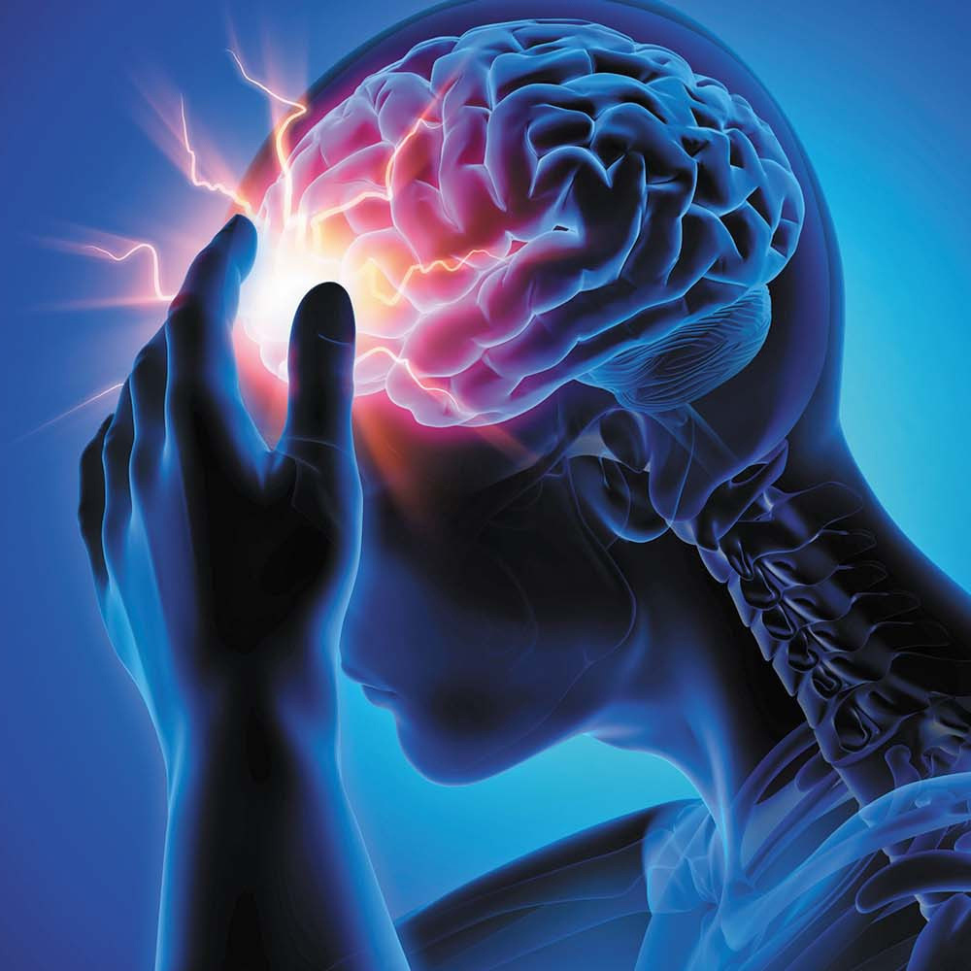

RSNA Intracranial Aneurysm Detection
Project Guide :
Mrs Athira S Nath
Assistant Professor
PROJECT CO-ORDINATORS :
DR.OJUS THOMAS LEE
ASSOCIATE PROFESSOR
DEPT OF CSE
COLLEGE OF ENGINEERING KIDANGOOR
JISHA C THANKAPPAN
ASSISTANT PROFESSOR
DEPT OF CSE
COLLEGE OF ENGINEERING KIDANGOOR
Presented by :
Alen Sebastin (KGR22CS012)
Muhammed Rayan (KGR22CS066)
Subash M (KGR22CS090
Tobin Tom (KGR22CS094)
Ajas Ajmal (LKGR22CS101)

Slide 2


CONTENTS
1 . ABSTRACT
2. INTRODUCTION
3. SYSTEM ARCHITECTURE
4. LITERATURE SURVEY
5. CONCLUSION
6. REFERENCES

Slide 3
ABSTRACT
INTRACRANIAL ANEURYSMS ARE ABNORMAL DILATIONS OF BLOOD VESSELS IN THE BRAIN THAT MAY RUPTURE AND CAUSE LIFE-THREATENING HEMORRHAGE.
EARLY DETECTION AND LOCALIZATION ARE CRITICAL FOR TIMELY TREATMENT AND PREVENTION OF RUPTURE.
THIS PROJECT USES THE RSNA INTRACRANIAL ANEURYSM DETECTION DATASET, CONTAINING MULTI-SITE CTA, MRA, AND MRI SERIES WITH EXPERT ANNOTATIONS.
DEEP LEARNING MODELS ARE APPLIED TO AUTOMATICALLY CLASSIFY PRESENCE OF ANEURYSMS AND LOCALIZE THEM INTO 13 PREDEFINED BRAIN LOCATIONS.
THE GOAL IS TO BUILD A RELIABLE, GENERALIZABLE TOOL TO SUPPORT RADIOLOGISTS IN FASTER AND MORE ACCURATE ANEURYSM DETECTION.

Slide 4

Introduction
Problem significance : intracranial aneurysms are common but often missed due to small size, variability, and imaging complexity.
Clinical challenge : manual review of cta/mra scans is time-consuming and prone to diagnostic errors.
Project focus: develop an ai-based pipeline to automatically detect and localize aneurysms in large-scale brain imaging data.
Dataset: rsna provides a diverse, multi-institutional dataset with labeled aneurysm cases and segmentation subset for training robust models.
Methodology overview: preprocessing of dicom images, training of deep learning models (2d/3d cnns, segmentation networks), and evaluation with kaggle’s provided api

Slide 5
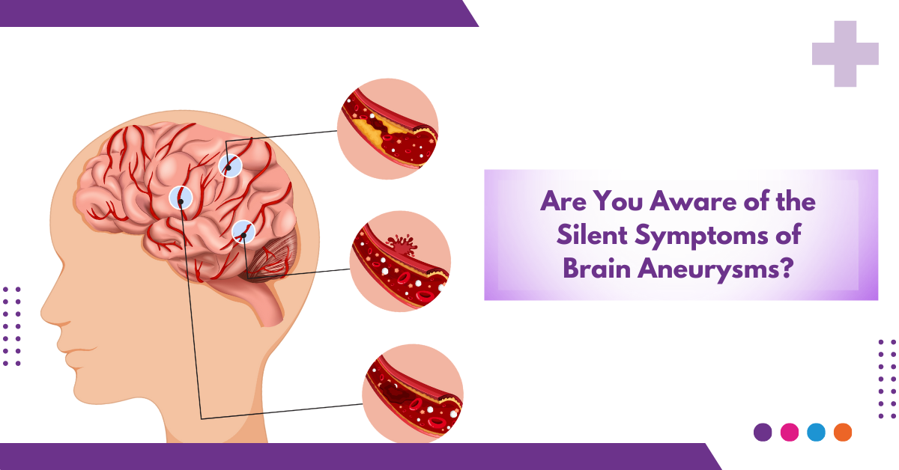
CONT....

Slide 6
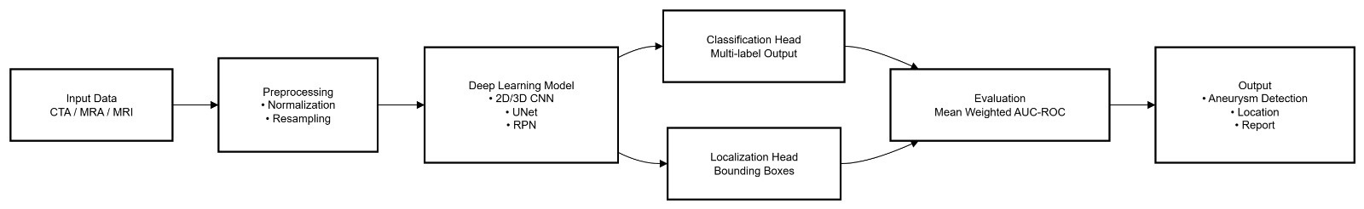
SYSTEM ARCHITECTURE

Slide 7
LITERATURE SURVEY
MANY RESEARCH STUDIES USE DEEP LEARNING MODELS LIKE 2D/3D CNNS AND U-NET TO DETECT AND SEGMENT BRAIN ANEURYSMS FROM CT AND MRI IMAGES.
LARGE DATASETS SUCH AS THE RSNA INTRACRANIAL ANEURYSM DETECTION DATASET PROVIDE MULTI-HOSPITAL DATA THAT IMPROVE MODEL TRAINING AND EVALUATION.
STUDIES SHOW THAT AI MODELS CAN ACHIEVE HIGH ACCURACY, BUT THEY OFTEN STRUGGLE WITH VERY SMALL ANEURYSMS AND NEED CAREFUL VALIDATION ACROSS DIFFERENT SCANNERS AND HOSPITALS.

Slide 8
Conclusion
Deep Learning Can Effectively Detect And Localize Intracranial Aneurysms, Helping Radiologists In Faster Diagnosis.
Preprocessing And Proper Data Handling Are Very Important To Get Reliable Results Across Different Hospitals.
Models Still Face Challenges With Small Aneurysms And False Positives, Which Need Improvement.
Using A Hybrid Pipeline (Preprocessing + 3d Segmentation + False Positive Reduction) Gives Better Accuracy.
With Further Validation And Clinical Testing, This Approach Can Support Doctors In Real-world Practice And Improve Patient Safety.

Slide 9
REFERENCES
Ž. BIZJAK AND Ž. ŠPICLIN, “A SYSTEMATIC REVIEW OF DEEP-LEARNING METHODS FOR INTRACRANIAL ANEURYSM DETECTION IN CT ANGIOGRAPHY,” BIOMEDICINES, VOL. 11, NO. 11, P. 2921, 2023. DOI: 10.3390/BIOMEDICINES11112921
J. FENG, R. ZENG, Y. GENG, ET AL., “AUTOMATIC DIFFERENTIATION OF RUPTURED AND UNRUPTURED INTRACRANIAL ANEURYSMS ON CTA USING DEEP LEARNING AND RADIOMICS,” INSIGHTS INTO IMAGING, VOL. 14, P. 76, 2023. DOI: 10.1186/S13244-023-01423-8
Z. SHI, B. HU, M. LU, ET AL., “ASSESSING THE IMPACT OF AN AI-BASED MODEL FOR INTRACRANIAL ANEURYSM DETECTION IN CTA ON PATIENT DIAGNOSIS AND OUTCOMES (IDEAL STUDY): TRIAL PROTOCOL,” TRIALS, VOL. 25, P. 358, 2024. DOI: 10.1186/S13063-024-08184-9

Slide 10
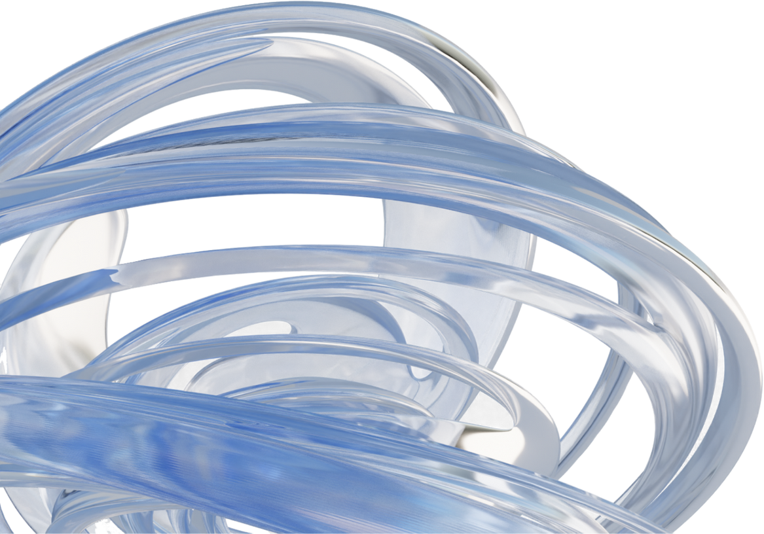
2025
THANK YOU

